Slide 1
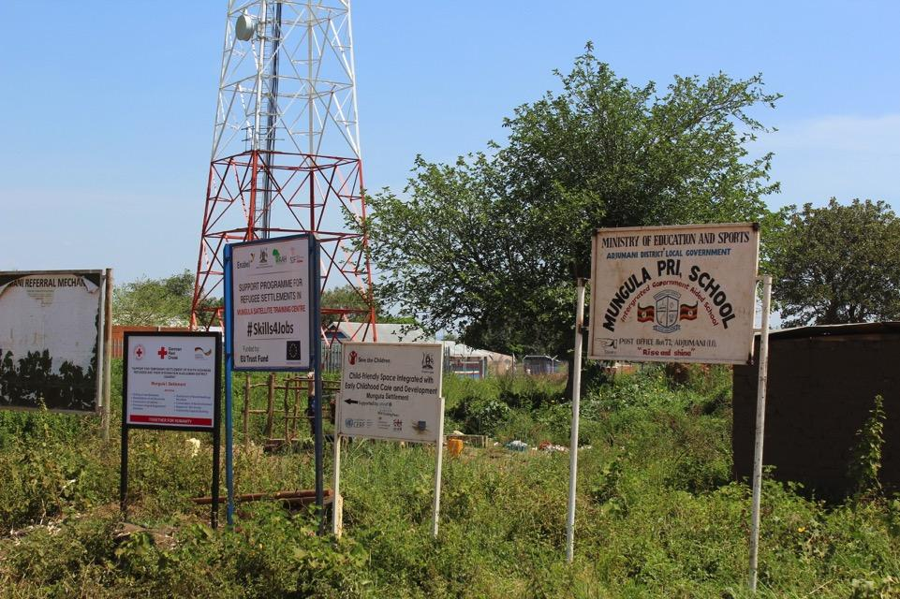

Towards the ‘Whole of Society’ Approach of Refugee Management in Uganda:
2018 Reflections & Recommendations
Presentation for Stakeholders’ Consultative Meeting
Uganda Human Rights Commission 2019
Onen David Ongwech
Project Manager, SRHR-EP - Refugee Law Project
Tel: +256 772 184 427
Email: gender@refugeelawproject.org

Slide 2
Outline of Presentation
Overview of
UG’s Refugee Pillars
Glimpse of
Practices and Challenges
Summary and
Recommendations

Slide 3
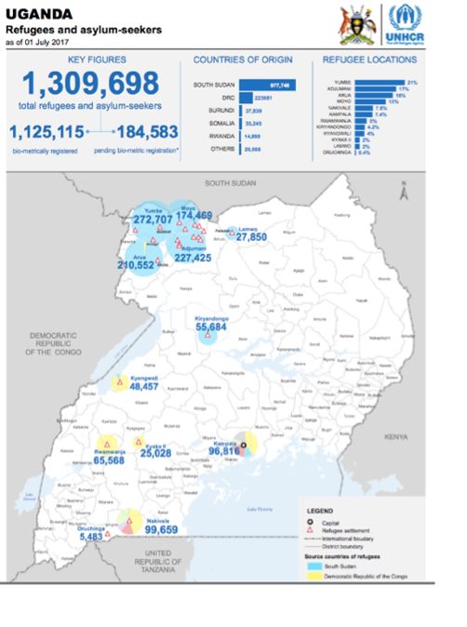
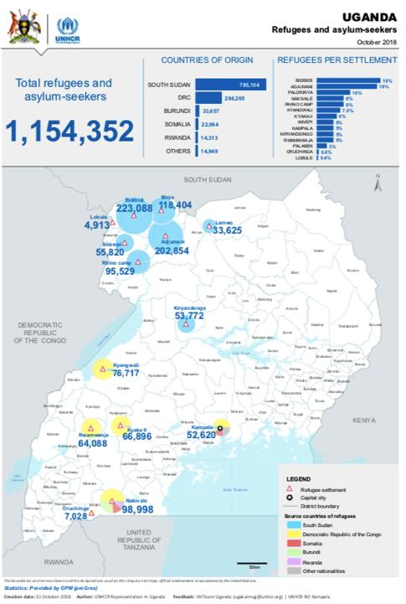
Uganda received the highest [ever recorded] refugee inflow in 2016 and 2017

Slide 4
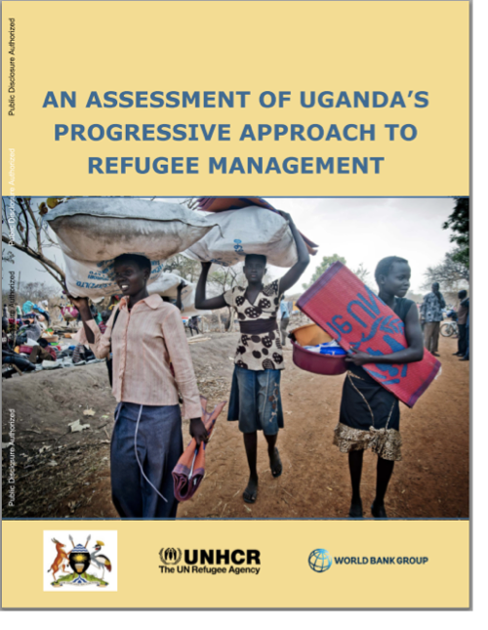
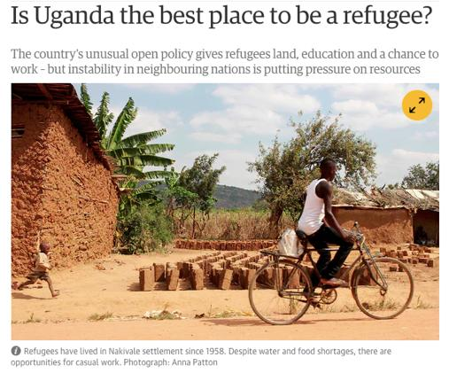
Features of Uganda’s Refugee Management Policy
Opening door to all asylum seekers
Granting relative freedom of movement
Providing prima facie asylum to certain nationalities
Providing land to each refuge family for agriculture
Notes:
For further reading, see (OPM 2016; Pilling 2017; Atuhaire 2016; Anon 2017; Macchiavello 2004)

Slide 5


UG’s Refugee Framework is Comprehensive in Scope and Progressive in Content
s
Pillars of Uganda’s Refugee Management Policy
Equality, dialogue and mutual support
Sustainable livelihoods support
Inclusion of refugees in local government systems
A positive progress away from
Marginalisation
Dependency
Xenophobia
Notes:
For more information, see Clements et al. (2016: 49)

Slide 6
Dating back to the 1940s, Uganda has hosted approximately 161,000 refugees yearly
Ethiopian has shown interest in trying match its policies to Uganda’s by adjusting its refugee policy regarding employment rights
Kenya is considering granting refugees small plots of land and allowing them to cultivate and sell their produce
Inspired
World Leader
Forward-thinking
The ‘Germany’ of Africa
Most generous
Progressive
Awe-inspiring
Unique model
Best place to be a refugee
Best refugee policy in the world
Common attribution of Uganda’s refugee management regime

Slide 7
UG’s Refugee Management - A history of generosity?
Koboko Partnership
ReHoPE 2016
UG NDP II
CRRF 2017 Whole of Society Approach
SPRS-NU), March 2017
The Global Compact for Refugees
Refugee Appeals Board 2011
Alternative to Camps 2014
Refugee Regulations 2010
STA 2015-2020
The Koboko Partnership
SRS 1998
DAR-HA 2004
Refugees Act 2006
1995 UG Constitution
URP 2009

Slide 8
Policy Level

Slide 9
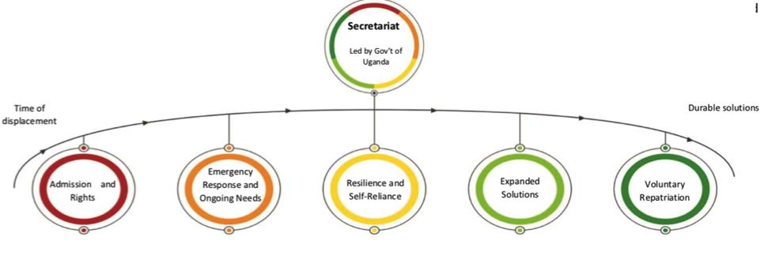
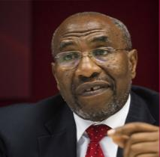
CRRF - Uganda
Moral Obligation
Materially Possible
Local Integration
Resettlement
Voluntary Repatriation
Humanitarian Response
Durable Solutions
“[CCRF]…re-affirms what we have always believed in -- handling refugee issues in a holistic manner”

Slide 10
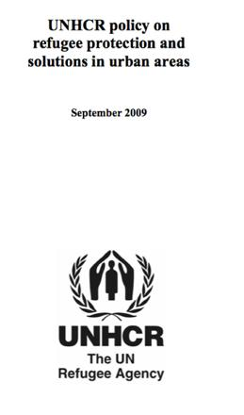
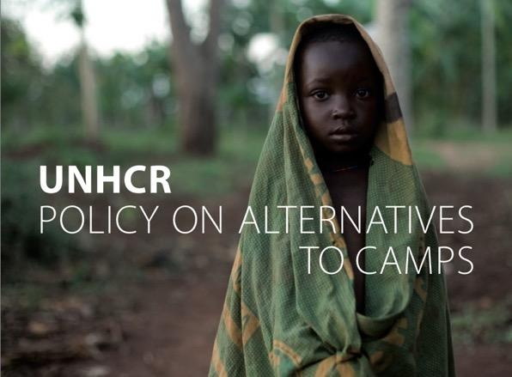
Expand the geographical scope of “urban refugee” definition
NO
Land apportioning
Rudimentary tool
Ratio card
Other relief items
Foster family s’pt
Hodgepodge of refugee actors
Arrival vaccination and medical check-up
UNHCR has 1 Implementing Partner in Kampala

Slide 11
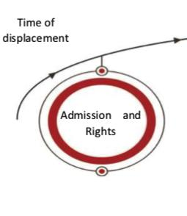
‘Admission’ for Urban Refugees?
How about ‘urban’ refugees residing in towns besides Kampala?
“Urban refugees should be helped on case-by-case bases” – Hon. Musa Ecweru, State Minister for Relief, Disaster Preparedness and Refugees, OPM
Moral Obligation
Political apathy?
“Refugees with some income, who are capable of taking care of themselves, are self-settled in urban centres where they rent housing” – ReHoPE Strategic Framework (June 2017)
“Urban refugees remain recognized… but UNHCR and Government doesn’t cater for them… If they need help, they should go back to gazetted areas” – David Apollo Kazugu, Former Commissioner for Refugees, OPM.
Notes:
OPM, UHCR, WB: ReHoPE – Refugee and Host Population Empowerment. Strategic Framework – Uganda (June 2017)

Slide 12
Treat & Rehabilitate War-related Injuries
Self-reliance is an important aspect of Uganda’s refugee frameworks
(The Refugees Act, SRS, STA, ReHoPE & CRRF)
Are some Refugees & Hosts WILLING, READY, & ABLE to ‘engage’?
Questioning the Physical and Psychological readiness

Slide 13
Address Registration Question
Some settlements including Kiryandongo was declared full and no-longer registering new cases save for family integration
However, a number of migrants survive in and around the settlement unregistered

Slide 14
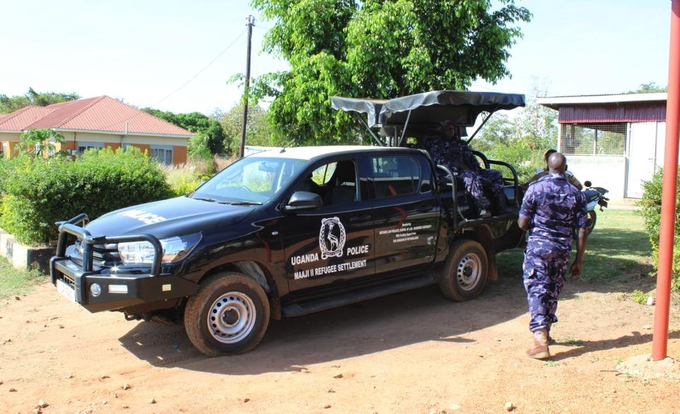
Access to Justice remains a herculean task

Slide 15
Access to Justice remains a herculean task
Conditions for difficult for refugees to meet (2 substantive sureties to be Ugandan)
  Language challenges (Court interpreters)
  Issues of overstay in remand
Transport and feeding for inmates coming to courts
  Lessons from Adjumani
  Cross examination on empty stomachs
30 days to regularize stay in Uganda is a huge challenge

Slide 16
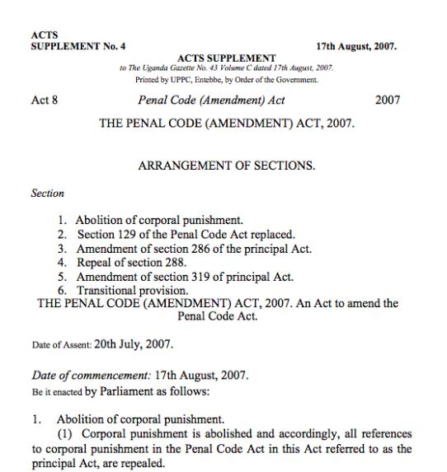
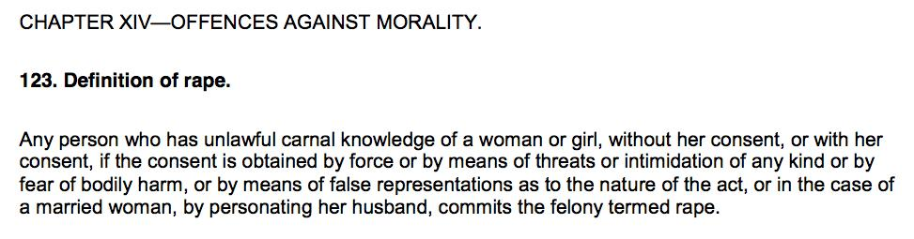
Legal reforms governing sexual violence esp. against men as victims/survivors

Slide 17


What is the breadth of the issue? – RLP’s Office (2018 figures)
6 in 10 are survivors/victims
2 in 10 are survivors/victims

Slide 18
What about children? (if over 50 percent of survivors say their children witnessed them being rape
20%
4%
?

Slide 19
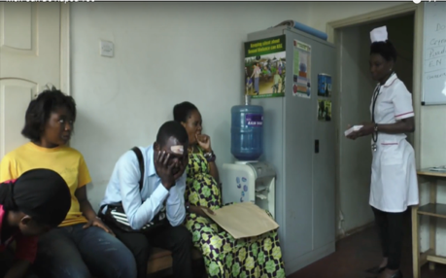
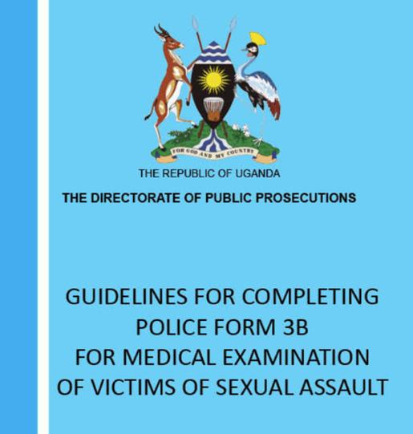
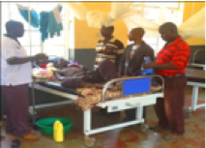
Practice?

Slide 20
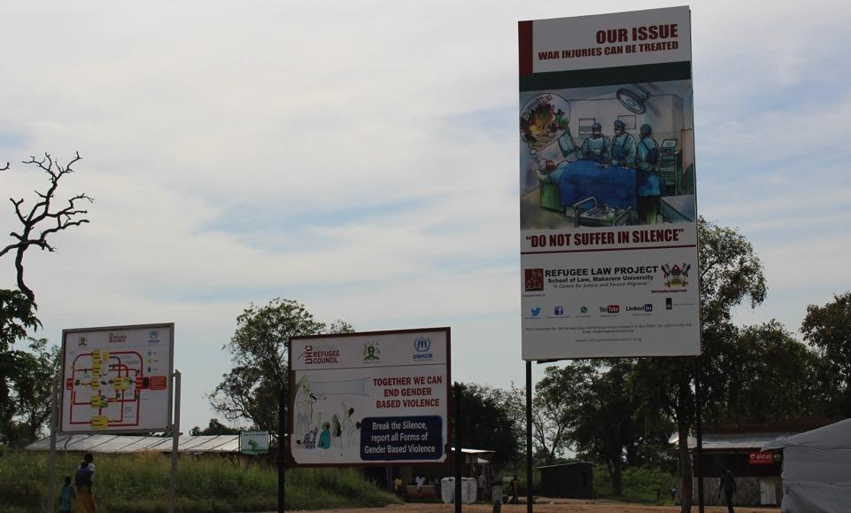
Address Physical and Psychological Harms

Slide 21
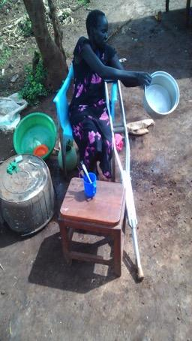
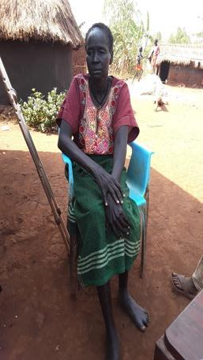
Emergency response and ongoing needs (CRRF), Strengthening service delivery (ReHoPE) need to address profound harms resulting from war-related injuries
Screen
Refer
Support
Document
Before Medical rehabilitation
Few weeks after medical rehabilitation
Systematic Screening for experiences of war is an important entry point

Slide 22
!!!Warning!!!
Graphical photos ahead
(Showing pre & post medical rehabilitation)

Slide 23
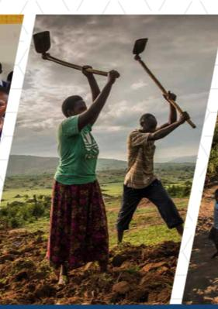
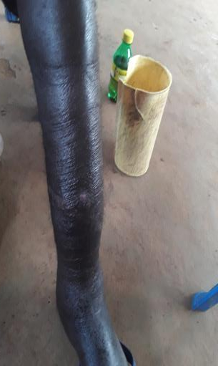
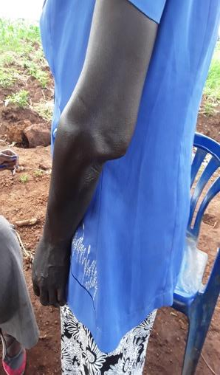
Address War-related injuries
Resilience & Self-Reliance (CRRF) and Sustainable Livelihoods (ReHoPE) are far-fetched for people grappling with war-related injuries

Slide 24
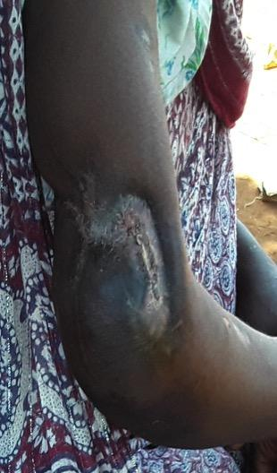
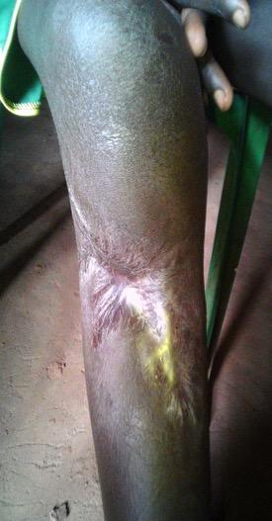
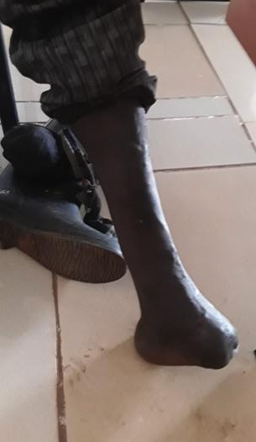
Resilience & Self-Reliance (CRRF) and Sustainable Livelihoods (ReHoPE) are far-fetched for people grappling with war-related injuries

Slide 25
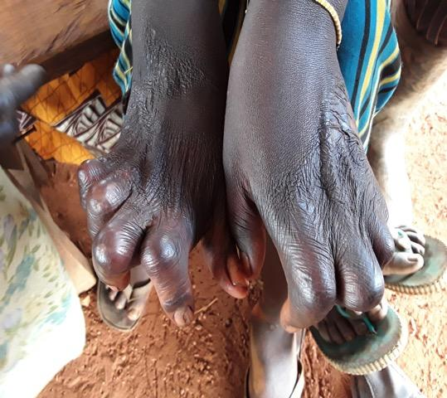
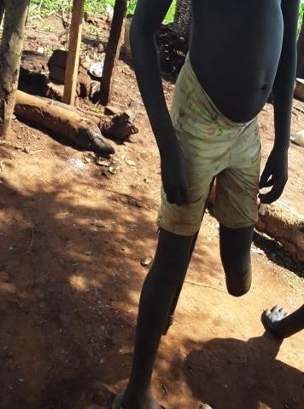
Resilience & Self-Reliance (CRRF) and Sustainable Livelihoods (ReHoPE) are far-fetched for people grappling with war-related injuries

Slide 26
Statistical Glimpse – RLP’s Best Practice 2018
1,474 M
2,822 F
20 SGNC)
Screened 4,316 (Jan-Dec 17 2018)
Identified 1,432 survivors of war-related injuries (33 percent) of those screened
Referred 1,054
(78m, 135f) clients
Supported recovery & healing for 1,054
Documented Satisfaction, Success Stories, Testimonies

Slide 27


Screen
Tackling Silences around CRSV
4,316
Screened
Experiences of war
(Before, During, & After Flight)
Which harms individual survivors, their immediate families, and communities
Profiling
Form
Screening Tool
(using PDAs)
65.4%
.5%
34.2%
33.2% Disclosure
1,432 disclosed of exp. of war-related injuries
Enabling disclosure for war-related injuries

Slide 28
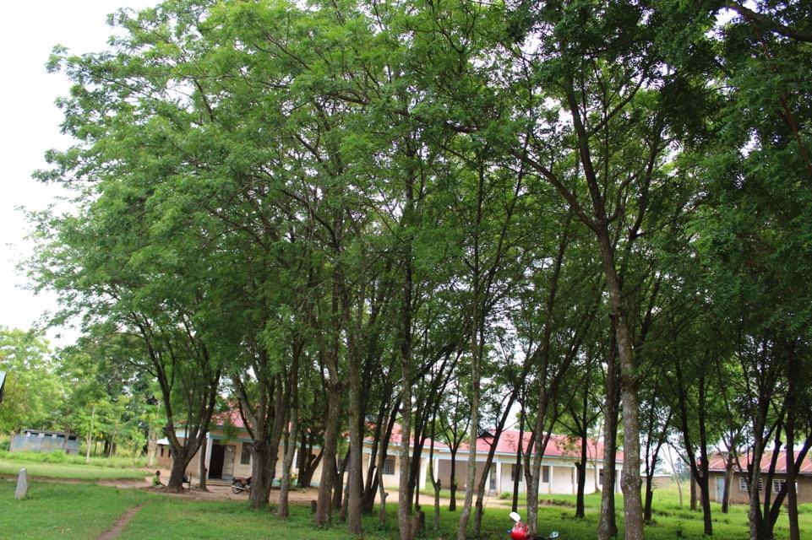
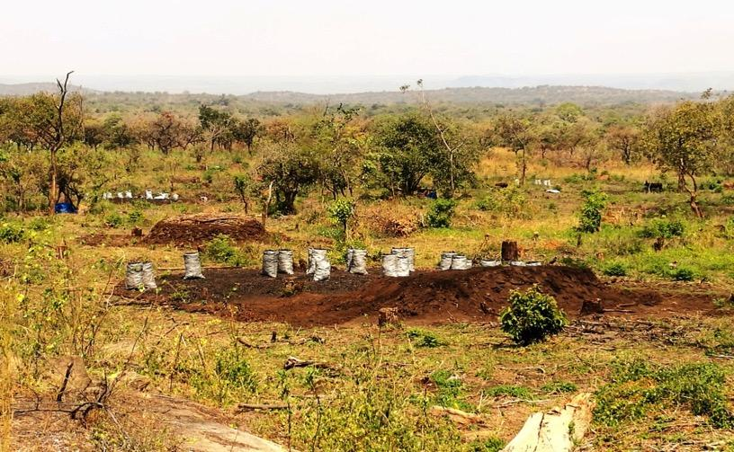
‘Orders from above appear not be be working’
Address Climate Change issues affecting refugees and hosts

Slide 29
Address Durable Solutions for Refugees (Especially Local Integration)

Slide 30
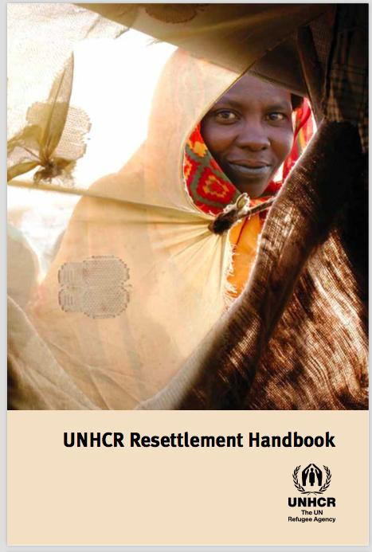
Renewed Commitment Towards Durable Solutions
Voluntary Repatriation
Contemporary conflicts have gradually evolved for the worse
Local Integration
Resettlement
1) More deadly for civilians
2) Increasingly protracted
VR - Conflicts drivers are still active
Over 19 years in DRC,
Over 23 in Somalia
3) Average years in exile is 26yrs
LI - is Legally unsupported
R - Political, Bureaucratic & reduced quota
Notes:
For more information, see Dryden-Peterson (2016: 5)
UNHCR, Global Trends: Forced Displacement in 2015

Slide 31
Local Integration
Legal, Economic and Socio-cultural process for permanent right to stay in the country of asylum
Uganda’s laws gives and takes at the same time. (refer to Article 12(2b))
Legal:
Constitutional petition by RLP & CPIL, a 15 year battle has not been successful
Over 5,000 application for naturalization remains shelved
Economic
& Socio-cultural:
Relative successes in refugee settlements but a long way to go for urban refugees
LI is a necessary transition from ‘Relief’ to ‘Development’ but appear unsupported
Notes:
Article 12(2b) of Uganda’s constitution provides possibility for refugees who have lived for 10 years in Uganda, from commencement of the constitution, to naturalize. However, subsequent sections complicates and denies naturalization for people whose parents or grandparents were refugees in Uganda

Slide 32
…Economic… process for permanent right to stay in the country of asylum
‘Freedom of Work’ remains a challenge due to requirements and processes
Opening door to all asylum seekers
Granting relative freedom of movement
Refugees Act 2006
Permits Required?
Providing prima facie asylum to certain nationalities
Immigration
Providing land to each refuge family for agriculture

Slide 33
Insert Slide on Ambassadorial Briefing

Slide 34
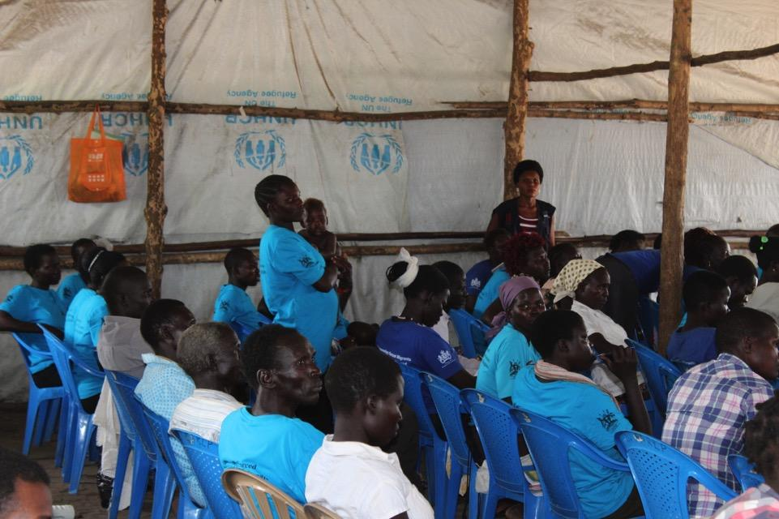
Address Language Barrier, Support Refugee Educations
Education Cannot Be Left Behind

Slide 35
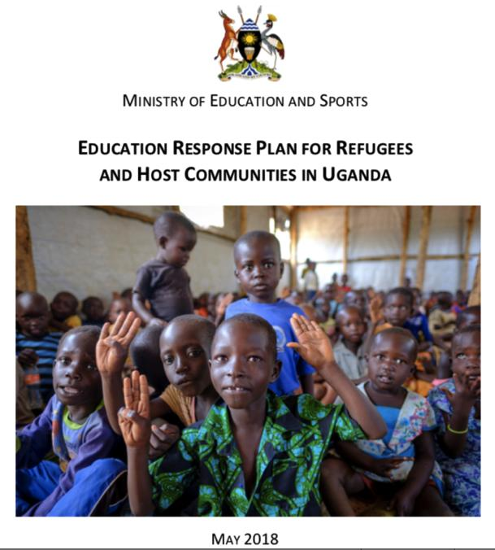
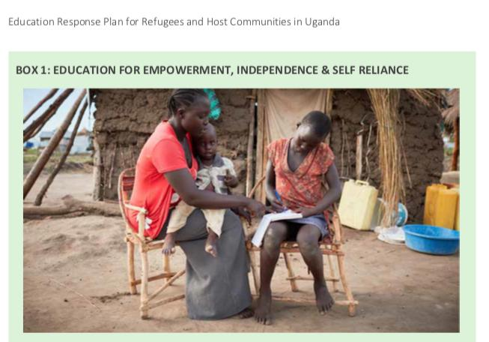
Address Language Barrier: Literacy for adult refugees is important and requires attention
Support education for Adult Refugees and Hosts who missed out on education as children

Slide 36
Address Land-related challenges between refugees and Host

Slide 37
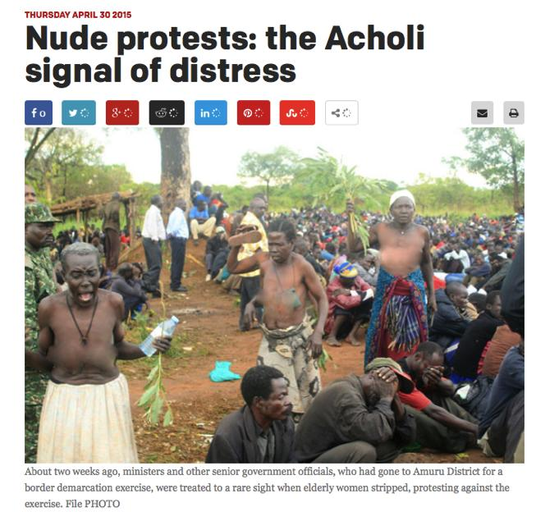
Address Land-related concerns and tensions frustrating refugee-host relations
Uganda is struggling with land-related conflicts
Notes:
The learning and successes of The Koboko Action Plan may never be realized sustainably if the land questions remains unaddressed

Slide 38
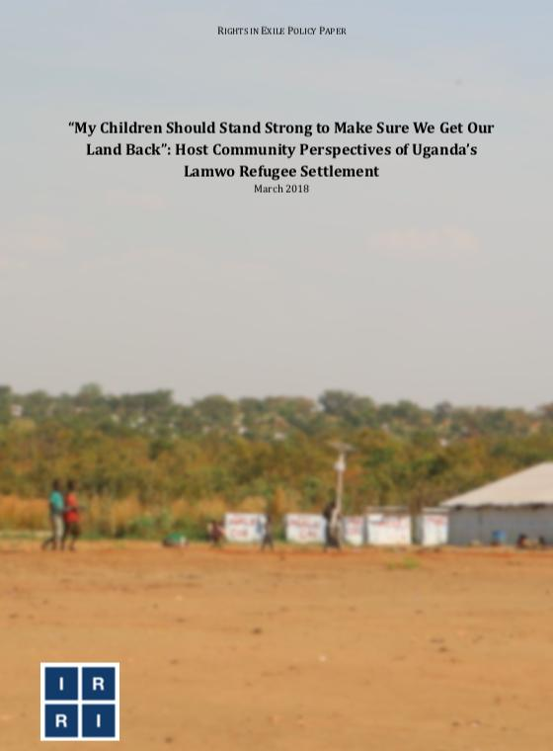
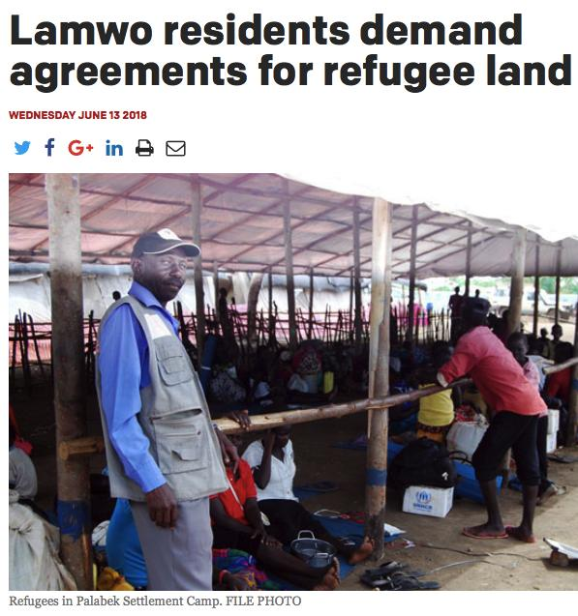
Have we looked at the land agreement?
Does it remind us about lives lost due to clashes (including former settlement commandant of Rwamwanja)?
Notes:
The Land Agreements require re-examination and legal oversight

Slide 39
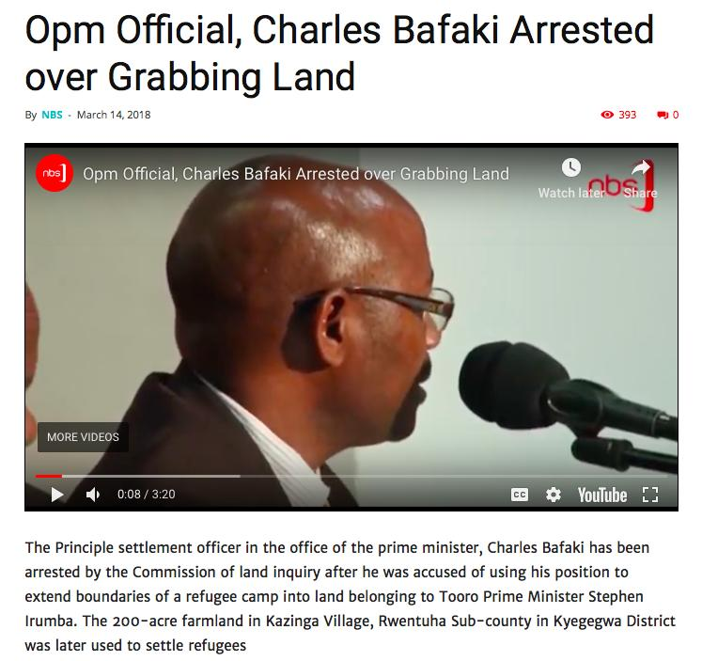
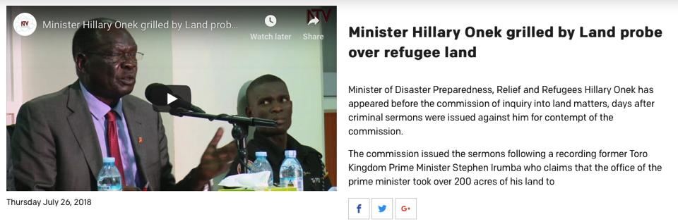
“If that land [given to refugees] was used for maybe farming and other activities, may be we would be getting more out of it. But it is now lying idle because because refugees are there. Maybe we need to assess the value of giving out this land and add it to our financial contribution”. – Hon. Hilary Onek

Slide 40
Sensitize refugees and host on
30 – 70 percent

Slide 41
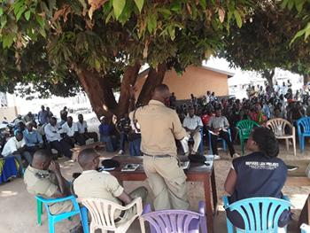
Sensitize refugees and host on 30 – 70 percent
What does the acronym CRRF & ReHoPE mean to refugees & host communities?
In 2017, the High Commissioner at the UNHCR Annual NGO Consultations suggested (jokingly) for a renaming competition [for CRRF]
Refugees & Hosts are asking for 100%, not 70 – 30)
Transformative participation is required
RLP’s Experience: Many refugees and hosts do not understand what CRRF & ReHoPE means

Slide 42
Strengthen Dialogues between district leaders hosting refugees

Slide 43
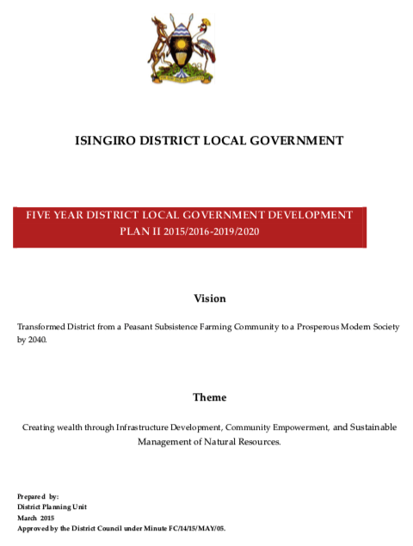
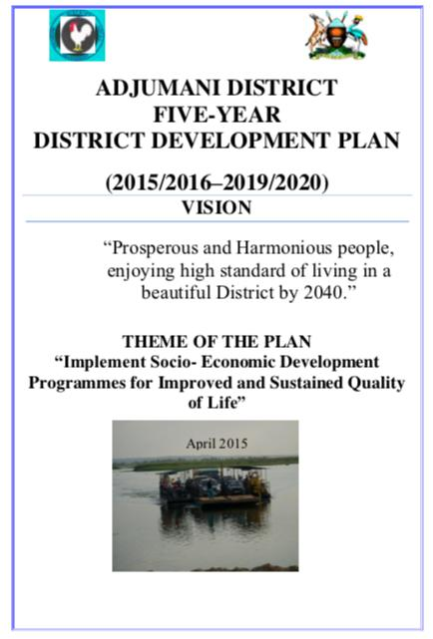
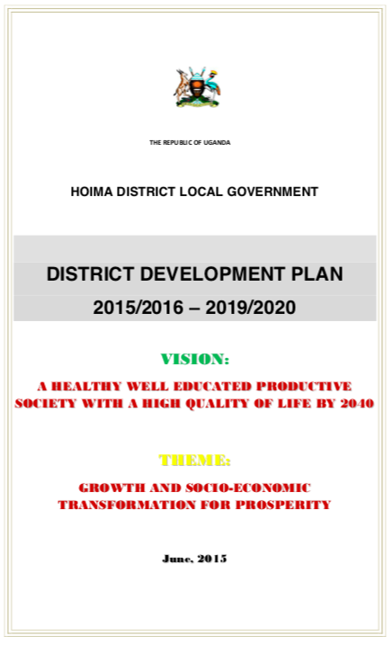
Supporting DLG to support refugees
How often do the district leaders meet to discuss refugee-host issues?
Support dialogues and symposiums for political & technical arm of government is important
Notes:
How much do LGs get from CG to support refugee management? (Lamwo – DRDIP UGX 3.1b) ReHoPE 1.6 billion (UNHCR)

Slide 44
Advocate for more resources for refugee management

Slide 45
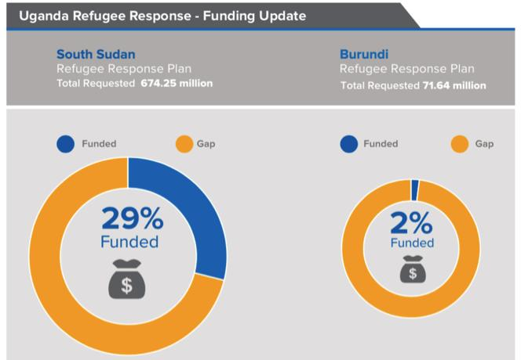
Advocate for more resources
Achieving the “whole of society” approach requires robust financial commitments
“Refugees are not our problem, they are a result of international politics, so why do we spent 58% on issues that are not ours? International bodies should take care of these problems” – Hon. Hilary Onek, Minister for Relief, Disaster Preparedness and Refugees.
End of 2016, Uganda’s refugee operation received only 37 percent of the funding requirement
But where will the money come from?

Slide 46
Uganda has a long history of a progressive refugee policy (dating back to 1959)
Progressive legislative and policy frameworks provides a ‘soft landing’ – but requires support
The ‘Transformative Strategies’ risk scrambling without commitment and renewed international support.

Slide 47
“The Framework [CRRF] is not a solution in itself but a platform for stakeholders to come together and find common solutions” – Dr. Ruhakana Rugunda, Prime Minister of the Republic of Uganda
Uganda Human Rights Commission’s Consultative Meeting is an important platform

Slide 48

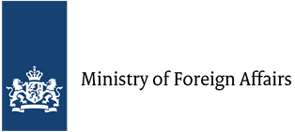
“Today, it is them, tomorrow, it could be any one of us.”
– Dr. Ruhakana Rugunda, Uganda’s Prime Minister
Ambition will be required for us to embrace the “whole of society” approach to refugee management
Thank you!
(including ‘head-on’ approaches)
With Funding Support from
gender@refugeelawproject.org
Courtesy of UNAIDS

